Slide 1
_ ×
Data Structures
List
Ja-Hee Kim@seoultech

Slide 2
Contents
01
02
ADT: List
Array List
03
04
Linked List
Variations

Slide 3
Data Structures . List
ADT: List

Slide 4

List
a set of names, numbers etc, usually written one below the other, for example so that you can remember or check them

Slide 5

ADT List
-
X
List
Responsibilities
add: append element x
add: insert element x into i^{th} position remove: delete element x
remove: delete i^{th} element
get: let the caller know what element is the i^{th} element indexOf: let the caller know what is the i^{th} element
clear: remove all entries form the list
size: gets the number of entries currently in the list.

Slide 6
ADT List
List is the ordered collection of data, and it allows duplicate elements
add(newEntry: T): Boolean
Apend newEntry to the list
Input
newEntry is the object to be added.
Postcondition: the list contains newEntry
Return:
true if adding is success
false if adding is fail
add(givenPosition: integer , newEntry: T): Boolean
Adds newEntry into the givenPoistion of the list
Input
givenPosition: the index where the newEntry will be located
newEntry is the object to be added.
Postcondition: the list contains newEntry in givenPosition
Return:
true if adding is success
false if adding is fail

Slide 7
ADT List
remove(anEntry: T): Boolean
Removes the first or only occurrence of anEntry from
the list.
Input: anEntry is the object to be removed.
Postcondition: the first anEntry does not exist in the list
Return: Returns true if anEntry was located and removed, or false if not. In the latter case, the list remains unchanged.
remove(givenPosition: integer): T
Removes and returns the entry at position givenPosition.
Input: givenPosition is an integer.
Postcondition: the element in the givenPosition does not exist in the list
Return: the object at the index givenPosition.

Slide 8
ADT List
get(givenPosition: integer ): T
Gets the element in the givenPosition
Input: givenPosition is an index.
Precondition: givenPosition has an element
Return: the object at the index givenPosition
indexOf(anEntry: T): integer
Gets the position of the first or only occurrence of anEntry.
Input: anEntry is the object to be found.
Return: the position of anEntry if it occurs in the list. Otherwise, returns the position where anEntry would occur in the list, but as a negative integer

Slide 9
ADT List
clear(): void
Removes all entries from the list.
Postcondition: the list does not have any element.
size(): integer
Gets the number of entries currently in the list.
Return: the number of entries currently in the list.

Slide 10
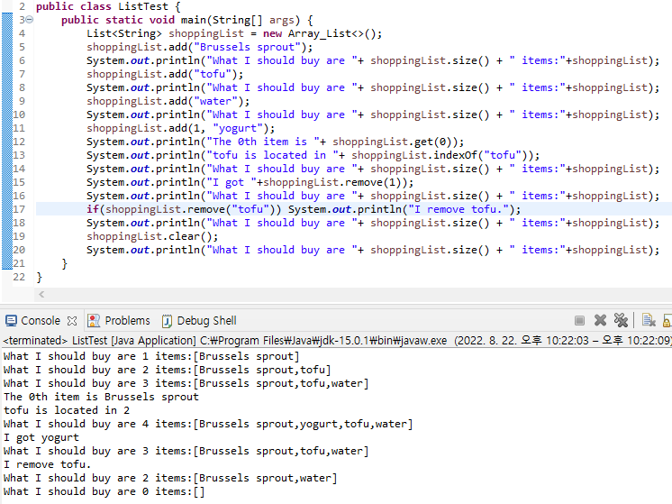




Example

Slide 11
Data Structures . List
Array List

Slide 12
Concept
public class ListTest {
public static void main(String[] args) {
List<String> shoppingList = new Array_List<>(5); shoppingList.add("Brussels sprout"); shoppingList.add("tofu"); shoppingList.add("water");
System.out.println("What I should buy are "+ shoppingList.size() + "
items:"+shoppingList);
shoppingList.add(1, "yogurt");
System.out.println("The 0th item is "+ shoppingList.get(0));
System.out.println("tofu is located in "+ shoppingList.indexOf("tofu")); System.out.println("What I should buy are "+ shoppingList.size() + " items:"+shoppingList); System.out.println("I got "+shoppingList.remove(1));
if(shoppingList.remove("tofu")) System.out.println("I remove tofu.");
shoppingList.clear();
System.out.println("What I should buy are "+ shoppingList.size() + " items:"+shoppingList);
}
}

Slide 13


Concept
public class ListTest {
public static void main(String[] args) {
List<String> shoppingList = new Array_List<>(5); shoppingList.add(0, "Brussels sprout"); shoppingList.add(1, "tofu");
shoppingList.add(2, "water");
System.out.println("What I should buy are "+ shoppingList.size() + " items:"+shoppingList);
shoppingList.add(1, "yogurt");
System.out.println("The 0th item is "+ shoppingList.get(0));
System.out.println("tofu is located in "+ shoppingList.indexOf("tofu"));
System.out.println("What I should buy are "+ shoppingList.size() + " items:"+shoppingList);
System.out.println("I got "+shoppingList.remove(1));
if(shoppingList.remove("tofu")) System.out.println("I remove tofu.");
shoppingList.clear();
System.out.println("What I should buy are "+ shoppingList.size() + " items:"+shoppingList);
}
}

Slide 14
Concept
public class ListTest {
public static void main(String[] args) {
List<String> shoppingList = new Array_List<>(5); shoppingList.add(0, "Brussels sprout"); shoppingList.add(1, "tofu");
shoppingList.add(2, "water");
System.out.println("What I should buy are "+ shoppingList.size() + " items:"+shoppingList);
shoppingList.add(1, "yogurt");
System.out.println("The 0th item is "+ shoppingList.get(0));
System.out.println("tofu is located in "+ shoppingList.indexOf("tofu")); System.out.println("What I should buy are "+ shoppingList.size() + " items:"+shoppingList); System.out.println("I got "+shoppingList.remove(1));
if(shoppingList.remove("tofu")) System.out.println("I remove tofu.");
shoppingList.clear();
System.out.println("What I should buy are "+ shoppingList.size() + " items:"+shoppingList);
}
}

Slide 15
Design Issue 1
How to declare data field
Array_List will hold a collection of objects one field can be an array of these object
Capacity:
the length of array vs. the number of element
user defined vs. default number
private final T list[];
private int numberOfEntries;
private static final int DEFAULT_CAPACITY=25;

Slide 16
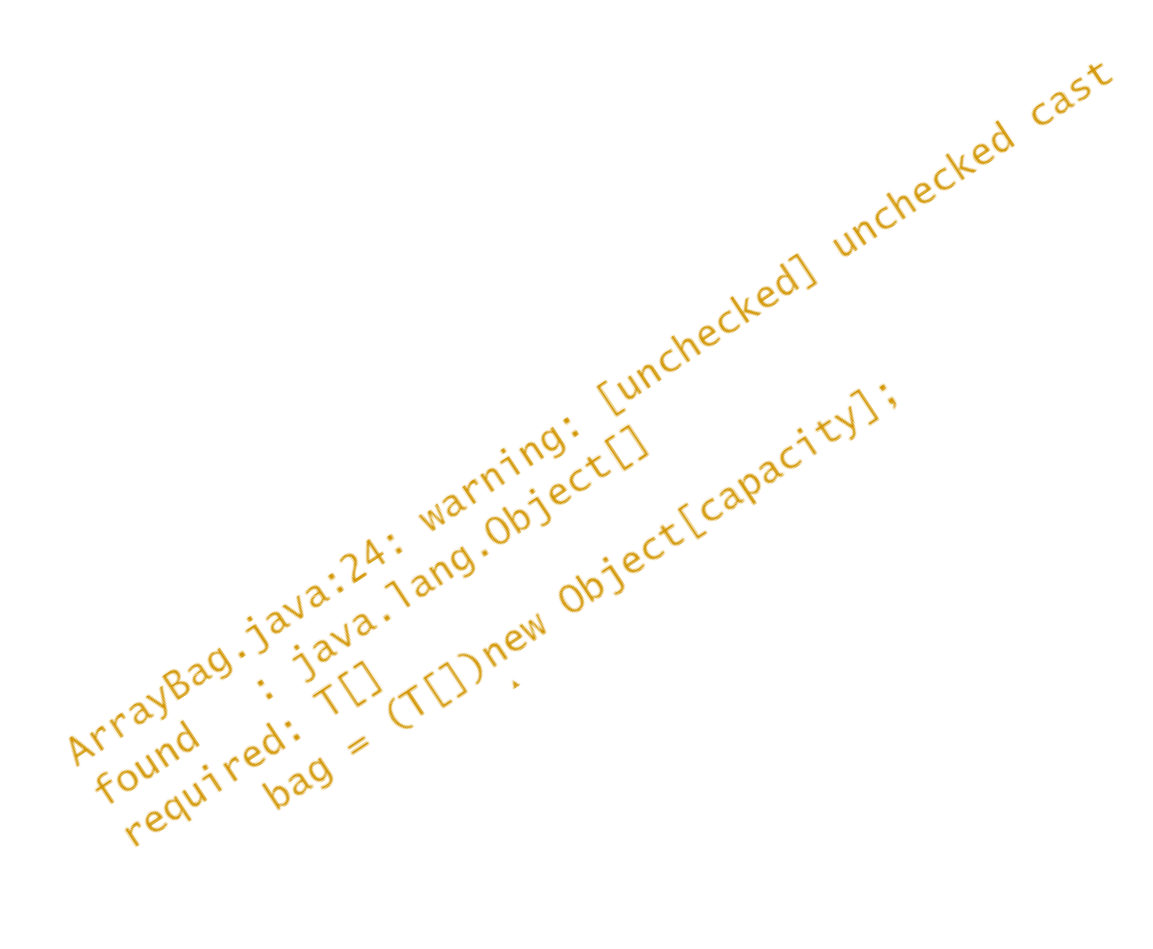
Design Issue 2
initializing the array of parameter T
What is the current initializing
Syntax error
list = new T[capacity]
list = new Object[capacity]
Missing type checking
list = (T[])new Object[capacity];
Suggestion
@SuppressWarnings("unchecked")
T[] tempList = (T[])new Object[desiredCapacity]; list = tempList;
Suppressing compiler warnings
To suppress an unchecked-cast warning from the compiler, you precede the flagged statements with the instruction
@SuppressWarnings("unchecked")
Note that this instruction can precede only a method definition or a variable declaration.

Slide 17
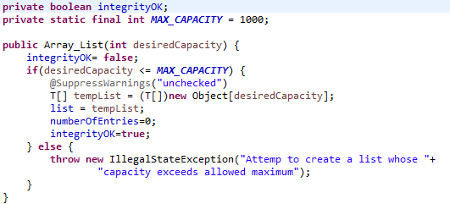
Design Issue 3
Fail-safe programming:
What happens if a client tries to create a List whose
capacity exceeds a given limit?
What happens if a constructor does not execute completely?

Slide 18
Design Issue 4
public T[] toArray(){ return list;
}
public T[] toArray() { checkIntegrity(); @SuppressWarnings("unchecked")
T[] result = (T[])new Object[numberOfEntries]; for(int i = 0 ; i < numberOfEntries ; i++)
result[i] = list[i]; return result;
}
A private data field should be changed only by the method.
However, if a client know the reference of a private data field, it can change freely without method of the ADT.
Ex: list=shoppingList.toArray(); list[0] = null;

Slide 19
Design Issue 5
Some code may be duplicated.
Integrity checking
Finding a certain entry: indexOf (T anEntry) remove(T anEntry)
Remove an item in a certain location remove(int givenPosition): boolean remove(T anEntry): anEntry
clear()
checkIntegrity() : void
indexOf (T anEntry)
removeEntry(int index): T

Slide 20
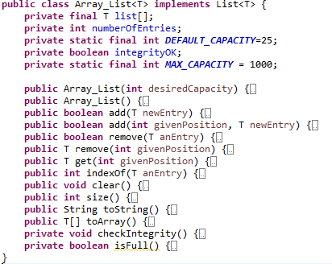
Array_List

Slide 21
Data Structures . List
Linked List

Slide 22
Analogy-Train
data | next
list:Node<T>

Slide 23
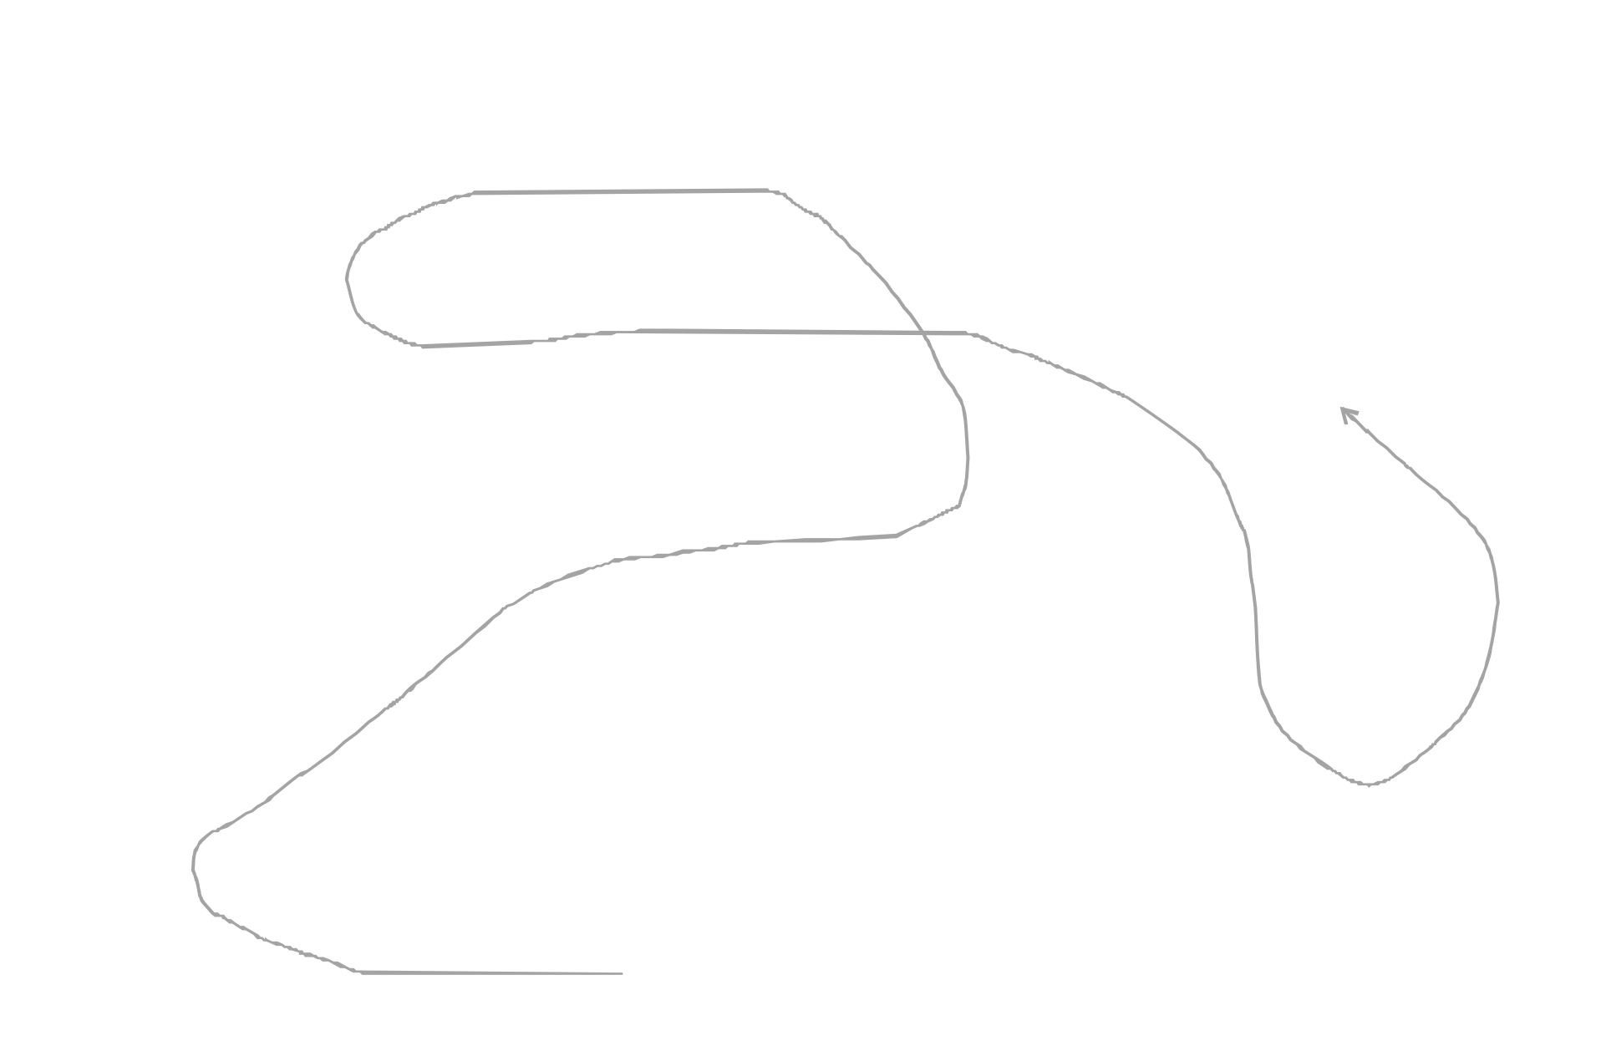






























Analogy
Network of Emergency Contacts
data | next

Slide 24


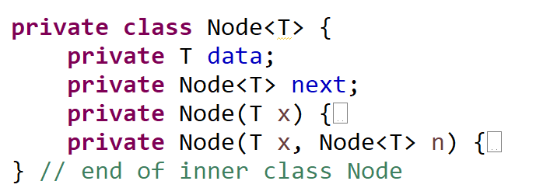




Node

Slide 25
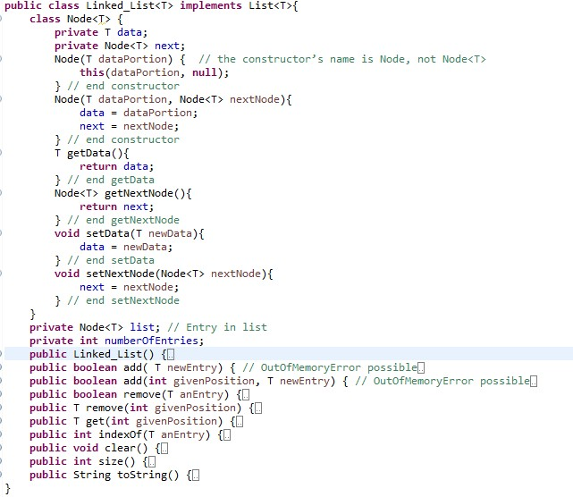
Node
Nested class:
defined in another
class definition
Inner class:
a nested class that is not static
Outer class = enclosing
class:
embeds a nested class
Top-level class = outermost class:
outer class that is not a nest class

Slide 26




Concept: add
Add
List<String> shoppingList = new Linked_List<>();
shoppingList.add("Brussels sprout");
Increase number of entries if the list is empty
shoppingList points the new node
shoppingList
numberOfEntries=0

Slide 27


Concept: add
Add
shoppingList.add("tofu");
if the list is not empty find the last node
the last node points the new node
How can we know the last node?
shoppingList
shoppingList.next
shoppingList
numberOfEntries=1

Slide 28

Concept: add
Add
shoppingList.add(“water");
if the list is not empty find the last node
the last node points the new node
shoppingList
shoppingList.next
shoppingList
numberOfEntries

Slide 29


Concept: add
Add
shoppingList.add(1, “yogurt");
Q: How can we find the location with the given index?
A: temporary point
shoppingList
shoppingList.next.next
shoppingList
shoppingList.next.next.next shoppingList.next
numberOfEntries

Slide 30
Current point p
Counting with integer variable: i
Pointing the current node: p i = 0
1
p
shoppingList
numberOfEntries

Slide 31



size, toString
System.out.println(
"What I should buy are “
+ shoppingList.size() + " items:"+shoppingList);
p
shoppingList
numberOfEntries=3

Slide 32
indexOf
System.out.println(
"tofu is located in "+ shoppingList.indexOf("tofu"));
Index
1
=0
p
shoppingList
numberOfEntries=3

Slide 33


Remove with index
System.out.println("I got "+shoppingList.remove(1));
p
shoppingList
numberOfEntries= 2
3

Slide 34







Removing case
Removing a givenPosition
Case 1: the list is empty-return false
Case 2: index 0
shoppingList
Case 3: index is bigger than the size
Case 4: other case

Slide 35
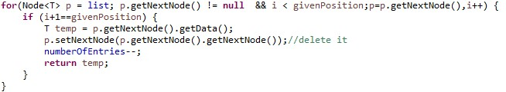

Removing
Case 4
check the data of p.next not p
p
p.next
shoppingList
numberOfEntries= 2
3

Slide 36
Remove with data
if(shoppingList.remove("tofu"))
System.out.println("I remove tofu.");
p
shoppingList
numberOfEntries=2

Slide 37
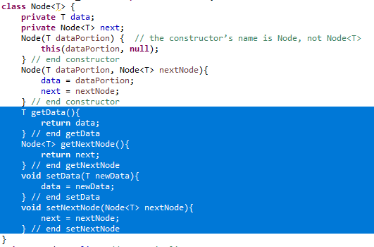
Design issue
Inner class vs package
We need getter and setter methods if you define
Node outside of Linked_List.
getter
setter

Slide 38
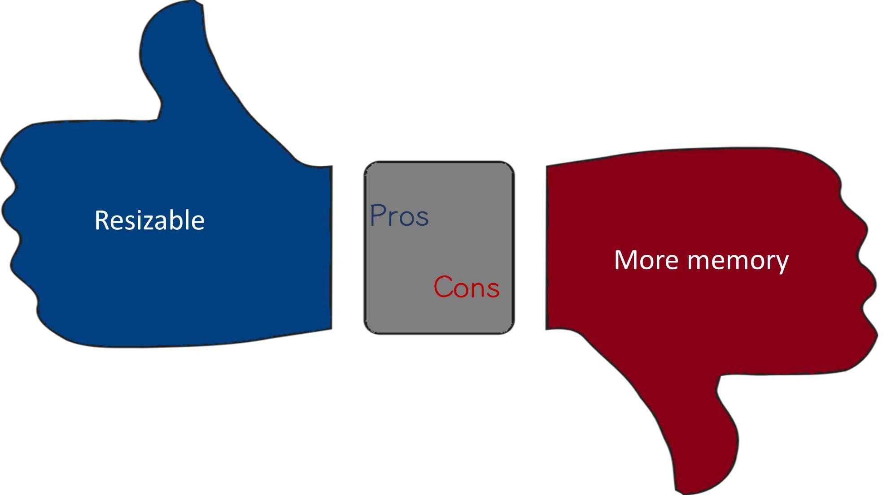
Comparing to Array_List

Slide 39
Time complexity
ADT operations | Array | Linked
add | O(n) | O(n)
remove | O(n) | O(n)
indexOf | O(n) | O(n)
clear | O(1) | O(1)
size, toArray | O(n) | O(n)

Slide 40
Data Structures . List
Variations

Slide 41
Agenda
Sorted List
Singly linked list
Doubly linked list
Circular linked list
The last node points to the first node instead of null.

Slide 42
ADT List
-
X
Sorted List
Responsibilities
add: Adds newEntry to the sorted list so that the list remains sorted remove: delete element x
remove: delete i^{th} element
get: let the caller know what element is the i^{th} element indexOf: let the caller know what is the i^{th} element clear: remove all entries form the list
size: gets the number of entries currently in the list.

Slide 43
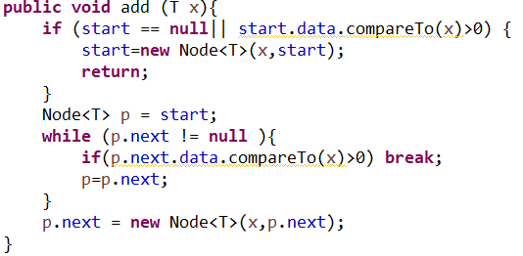
add
precondition: the list is in ascending order;
postcondition: the list is in ascending order, and it contains x
Cases
Case 1: empty sorted list
Case 2: insertion at the front of the list
Case 3: attach after the last node
Case 4: between two nodes

Slide 44




Case 1: empty sorted list
Client program:
list.add(“Jamie”);
start
Jamie
next

Slide 45







Case 2: insertion at the front of the list
Client program:
list.add(“Jamie”);
list.add(“Brenda”);
start
Jamie
next
Brenda
next

Slide 46



Case 2: insertion at the front of the list
Case 2: insertion at the front of the list
the next of the new node to start.next
start.next points the new node
start
Jamie
next
next
Brenda

Slide 47






Case 3: attach after the last node
Client program:
list.add(“Jamie”);
list.add(“Brenda”);
list.add("Tom");
start
Brenda
next
Jamie
next
Tom
next
p

Slide 48











Case 4: between two nodes
Client program:
list.add(“Jamie”);
list.add(“Brenda”);
list.add("Tom");
list.add("Carlos");
start
Brenda
next
Jamie
next
Tom
next
next
p
next
Carlos

Slide 49







doubly linked list
A node of a doubly linked list
a node = data + previous point + next point
prev
data
next
Class Node<T> {
T data; // for data field
Node prev; // for the previous node
Node next; // for the next node
}

Slide 50

























doubly linked list
Structure of a doubly linked list
The first and last nodes of a doubly linked list are immediately accessible
Advantage
Allows traversal of nodes in both direction
Deque can be implemented using a doubly linked list easily
list
head
tail
22
next
prev
33
next
prev
44
next
prev
55

Slide 51
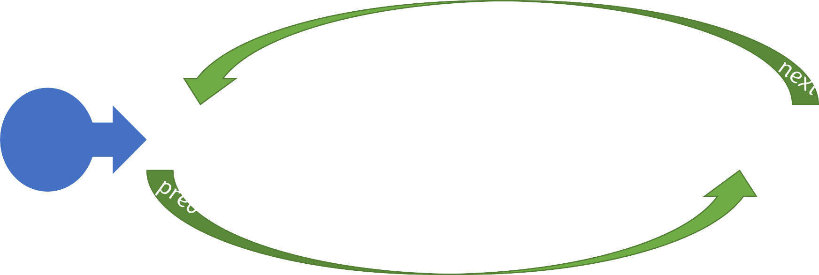
















Circular Linked List
The last node points to the first node instead of null.
It can be a singly linked list or a doubly linked list
start
22
next
prev
33
next
prev
44
next
prev
55

Slide 52
Thank you!
-
X
Questions?
Exit

